Slide 1
Finding cities with similar lifestyle
Initial attempt to tackle the problem using foursquare data
By Michael Chen
December 18, 2018

Slide 2
Introduction
Nowadays people frequently relocate to different cities due to job change or other reasons
People want to know in advance what the lifestyle of the destination city would be
Many prefer the lifestyle of destination city is similar to where they currently live in
A data-driven approach to analyze target cities can provide an objective decision support

Slide 3
Data sources used
City information data fetched from Wikipedia page(s). To simplify the scope, it is assumed the target cities are in California, U.S.A. (see Cities and Towns In California)
GEO info of latitude/longitude of each city is retrieved by using Python geopy/Nominatim
As an initial attempt, only FourSquare neighborhood venues data is used as major main input to evaluate lifestyle of a city

Slide 4
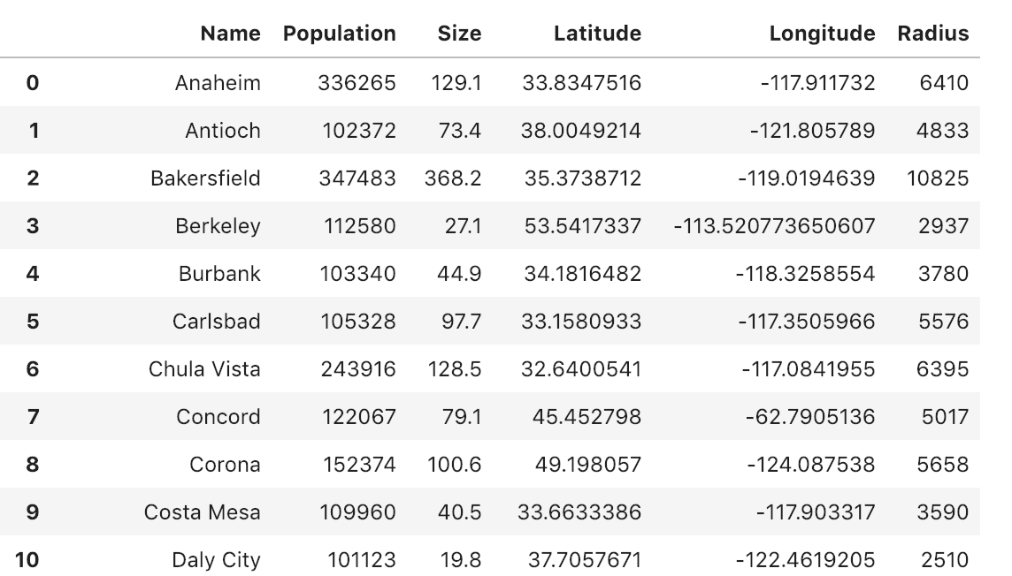
Prepared data format
The final pandas dataframe for analysis is shown below
City Data Frame Sample Rows

Slide 5
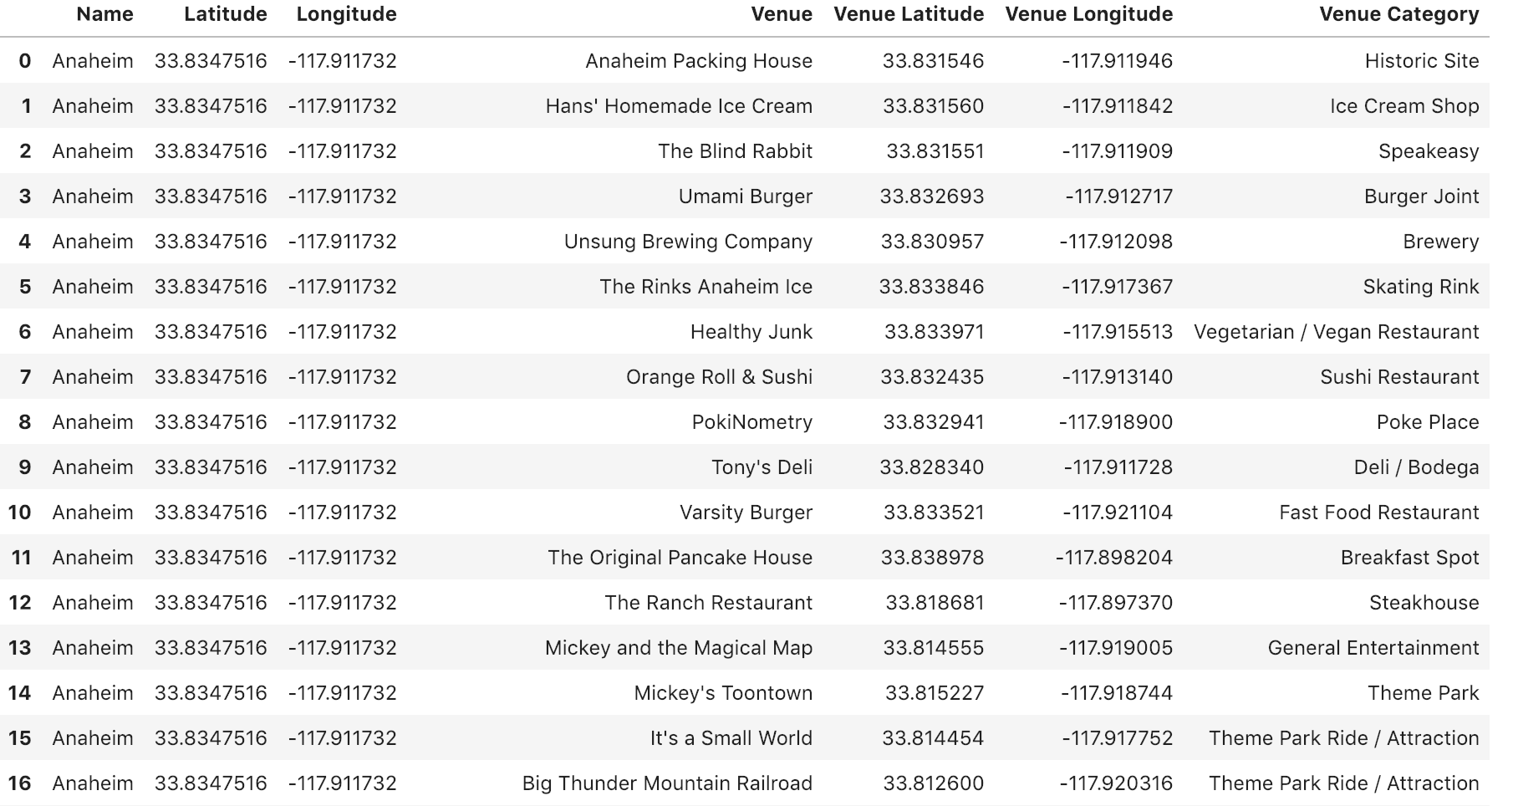
City Venues Data Frame Sample Rows

Slide 6
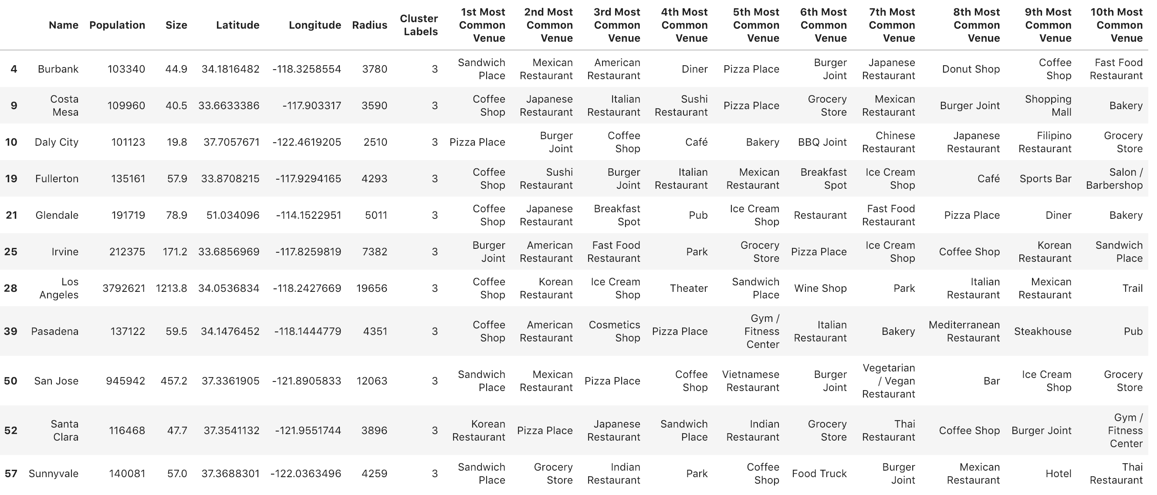
City cluster analysis
There are total 64 cities (with population > 100,000) selected for this experiment
100 venues are queried from FourSquare API (some cities may have less than 100)
K-mean clustering is used to cluster all 64 target cities into 20 clusters
The assumed old home city is Irvine, CA. In its cluster (cluster #3) there are 10 other cities that are all similar to Irvine

Slide 7
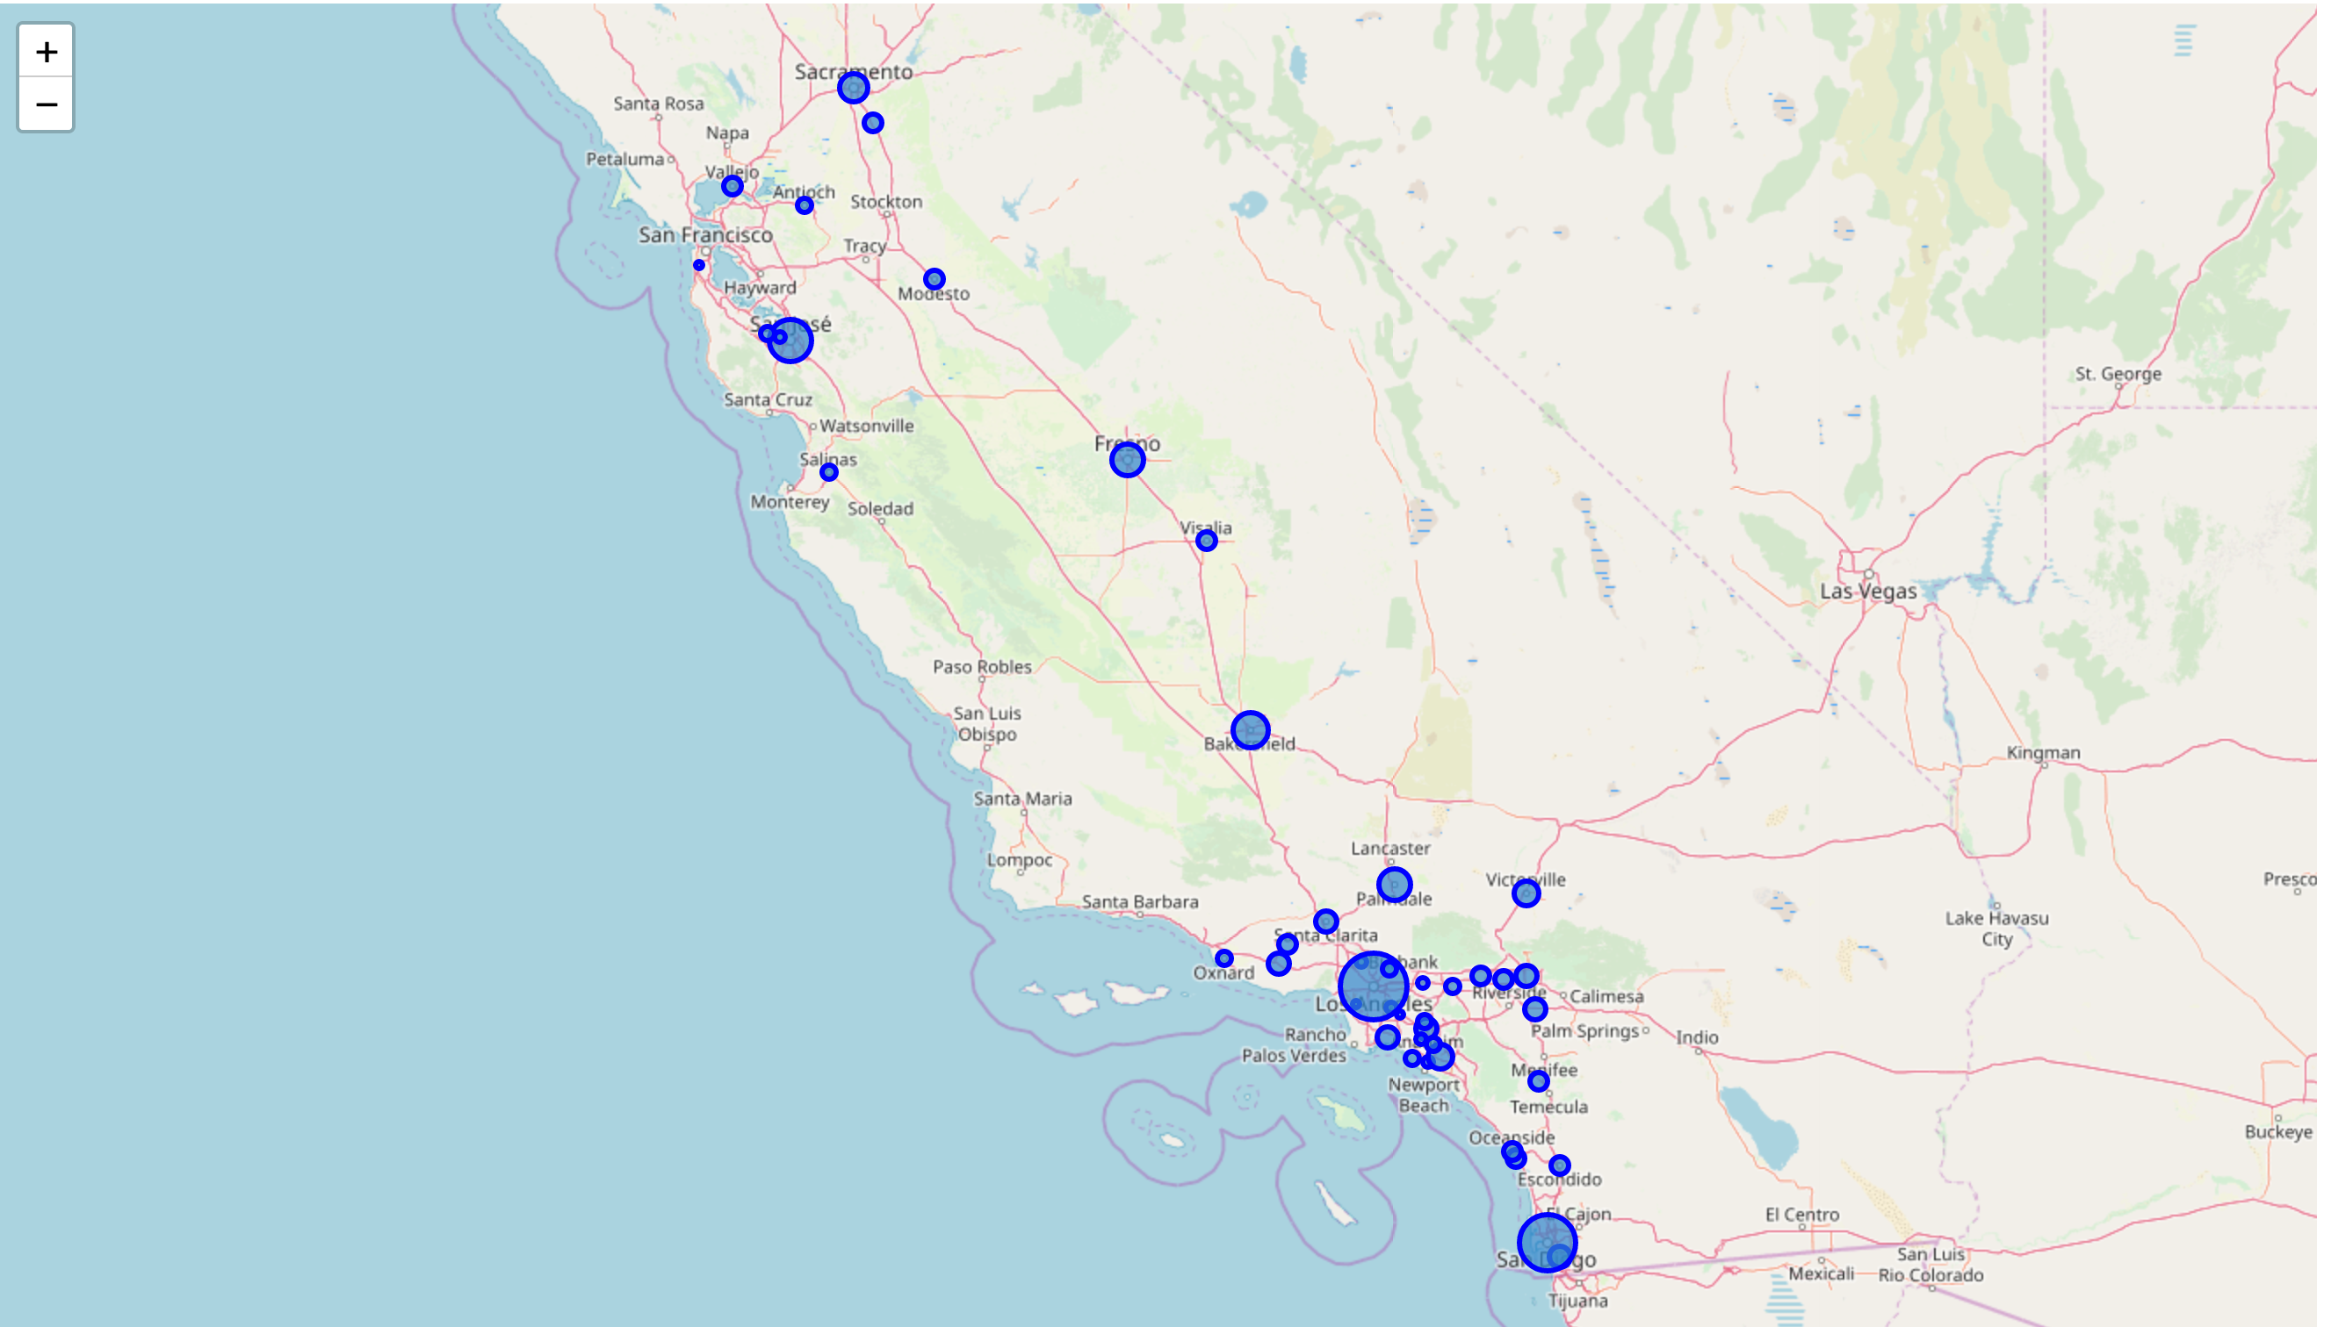
Results on map
California Cities Selected For Analysis

Slide 8
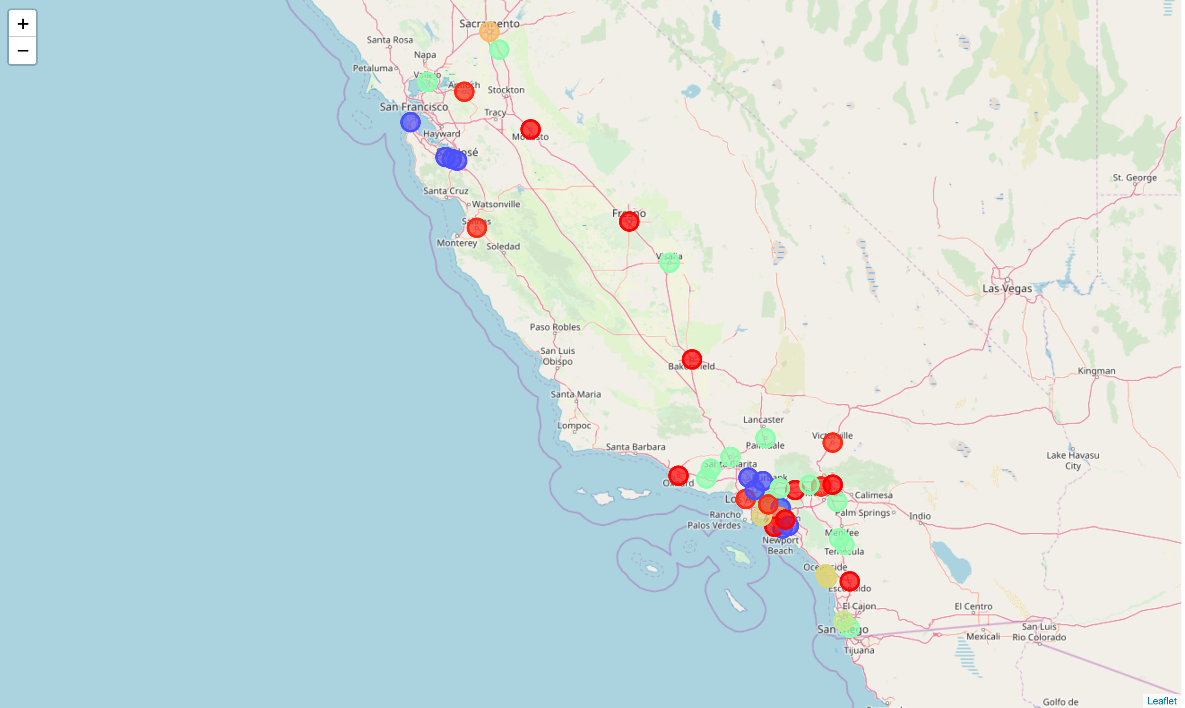
Cities That Belong To Same Cluster Of Home City Irvine (Blue Circles)

Slide 9
Conclusions
K-mean clustering works reasonably well to group cities by their venues similarity
Final accuracy depends on data quality, currently the FourSquare venues data has been observed as not complete – neither number of samples nor representative of samples can be guaranteed
Other data sources are needed to enrich other aspects of lifestyle of a city – such as schools, hospitals, sports facilities, event centers, etc. to improve the effectiveness of the lifestyle comparison

